Slide 2
God’s family living and sharing the Good News of Jesus in Burpham

Slide 3
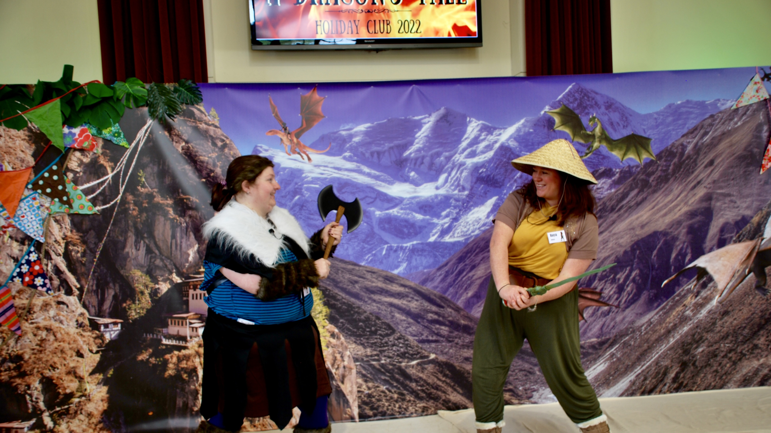

Slide 4
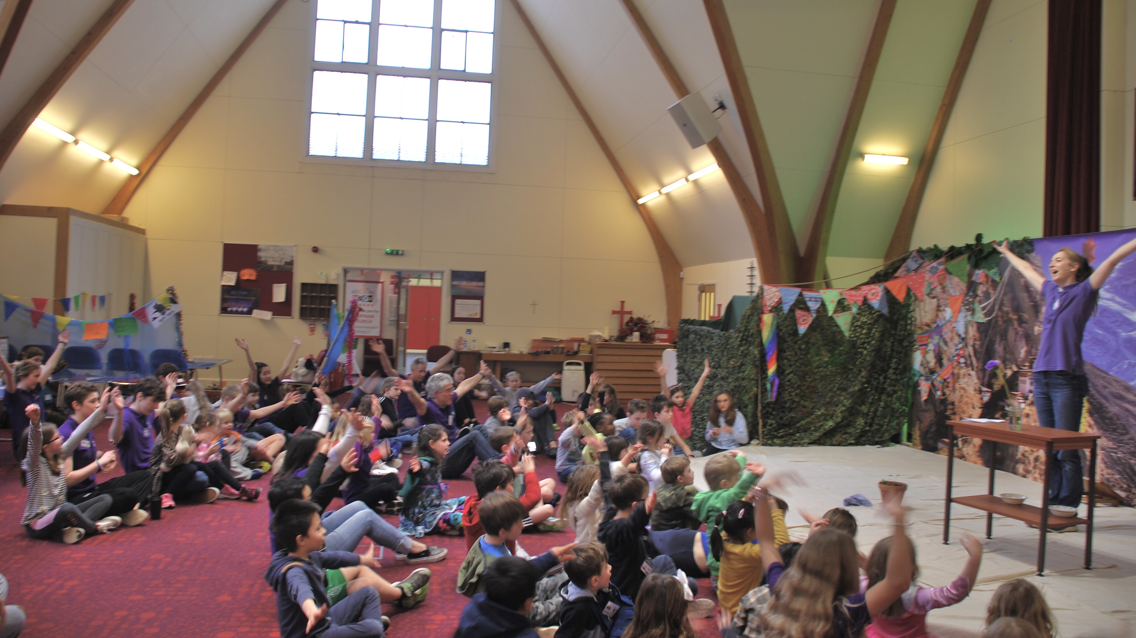

Slide 5
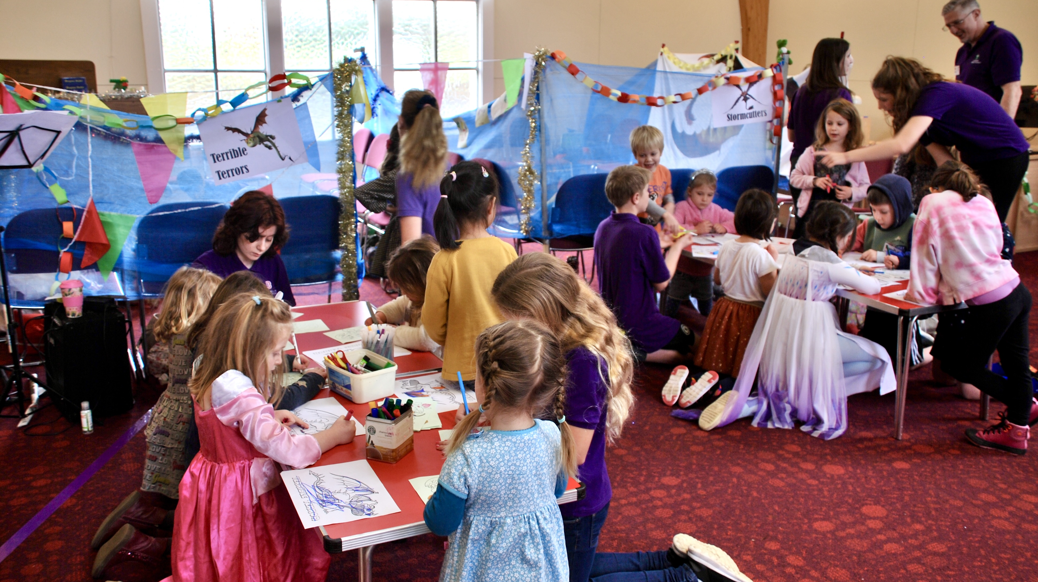

Slide 6
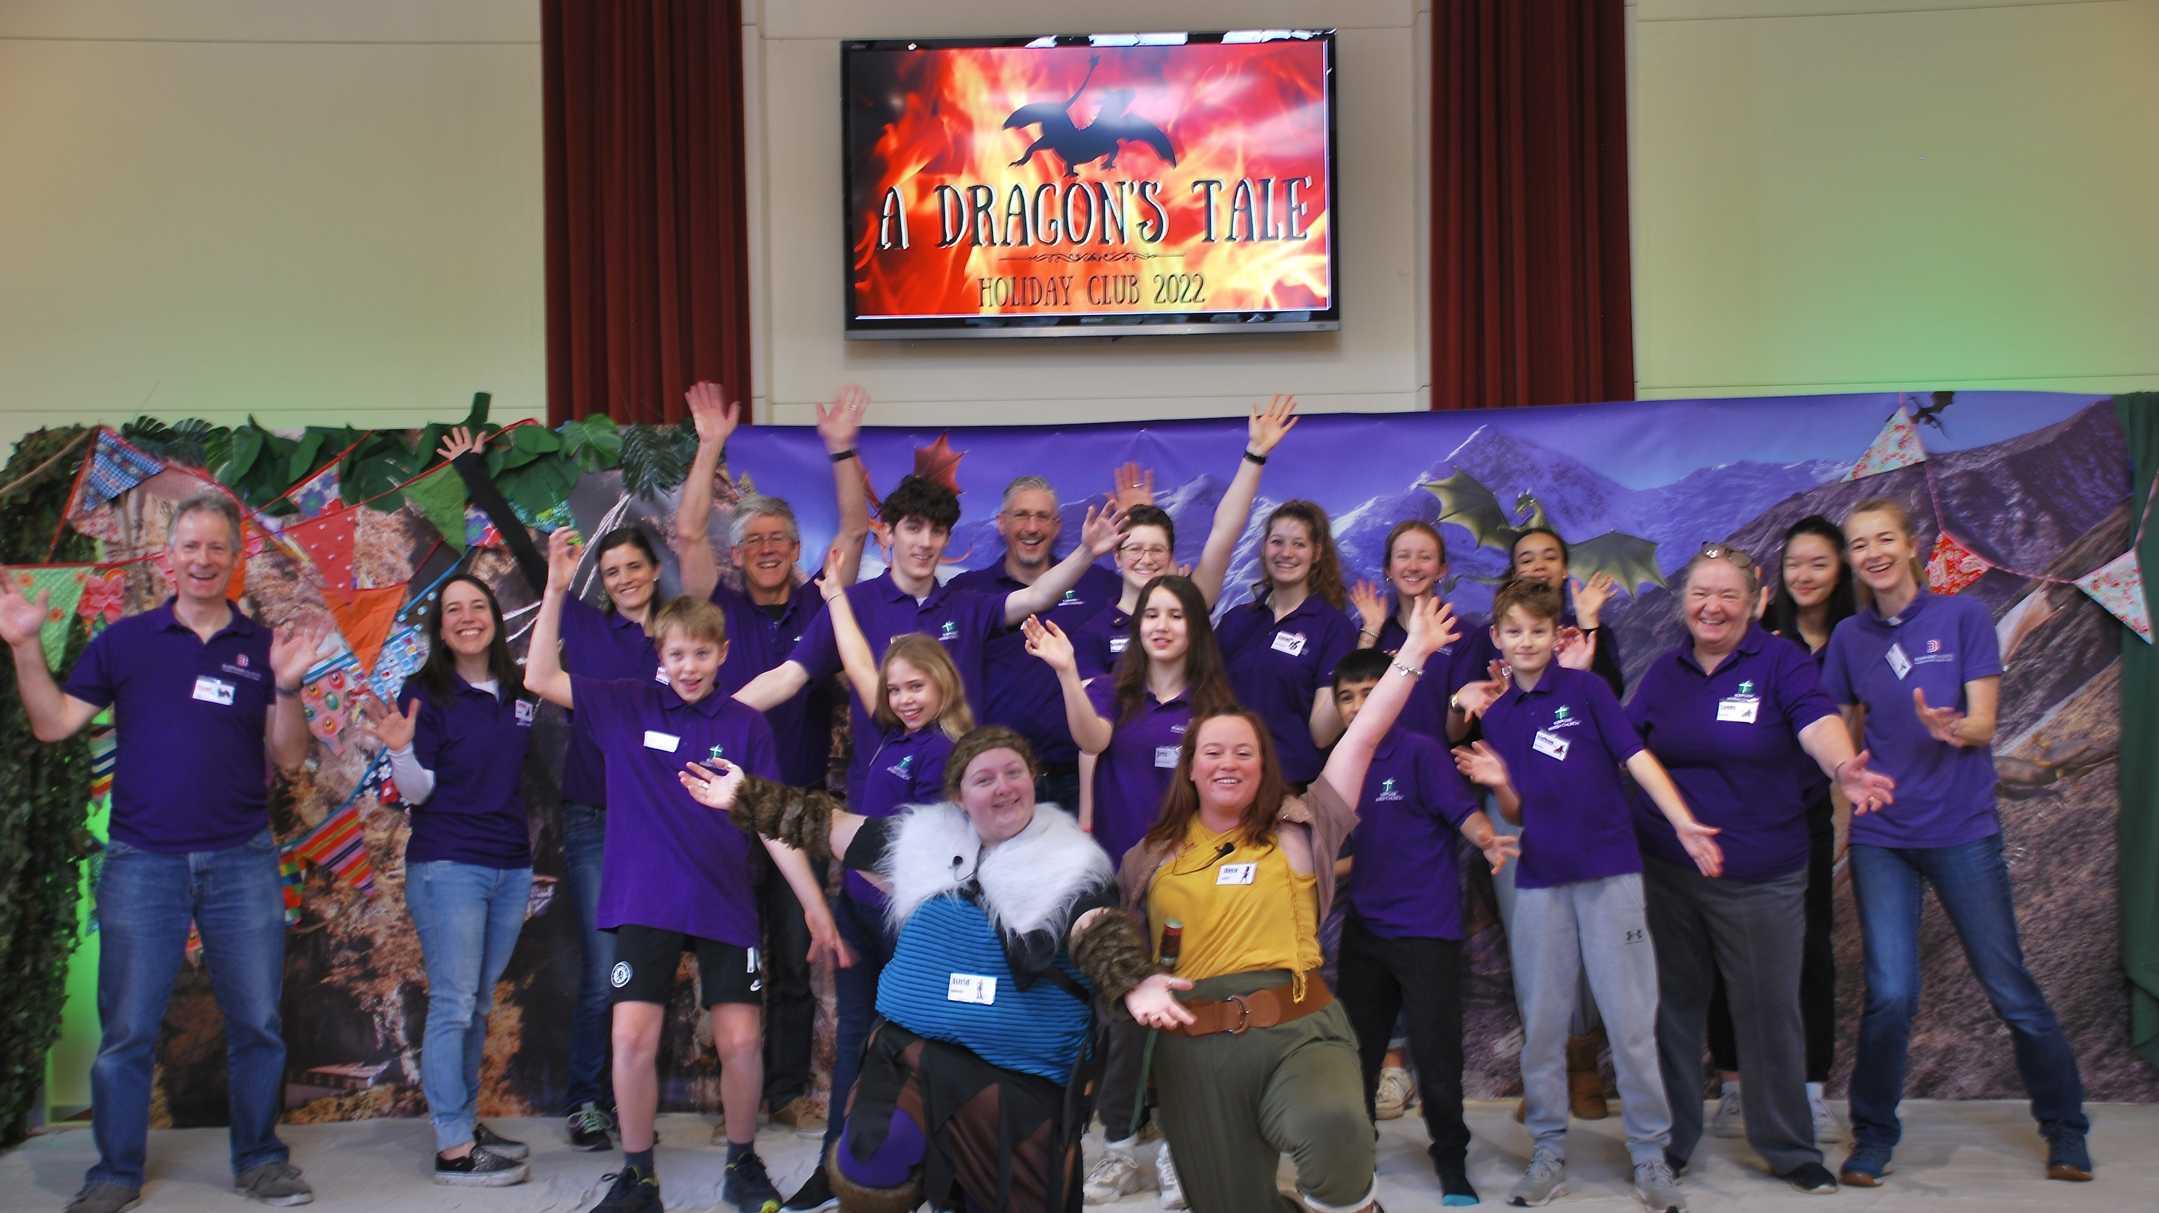

Slide 7
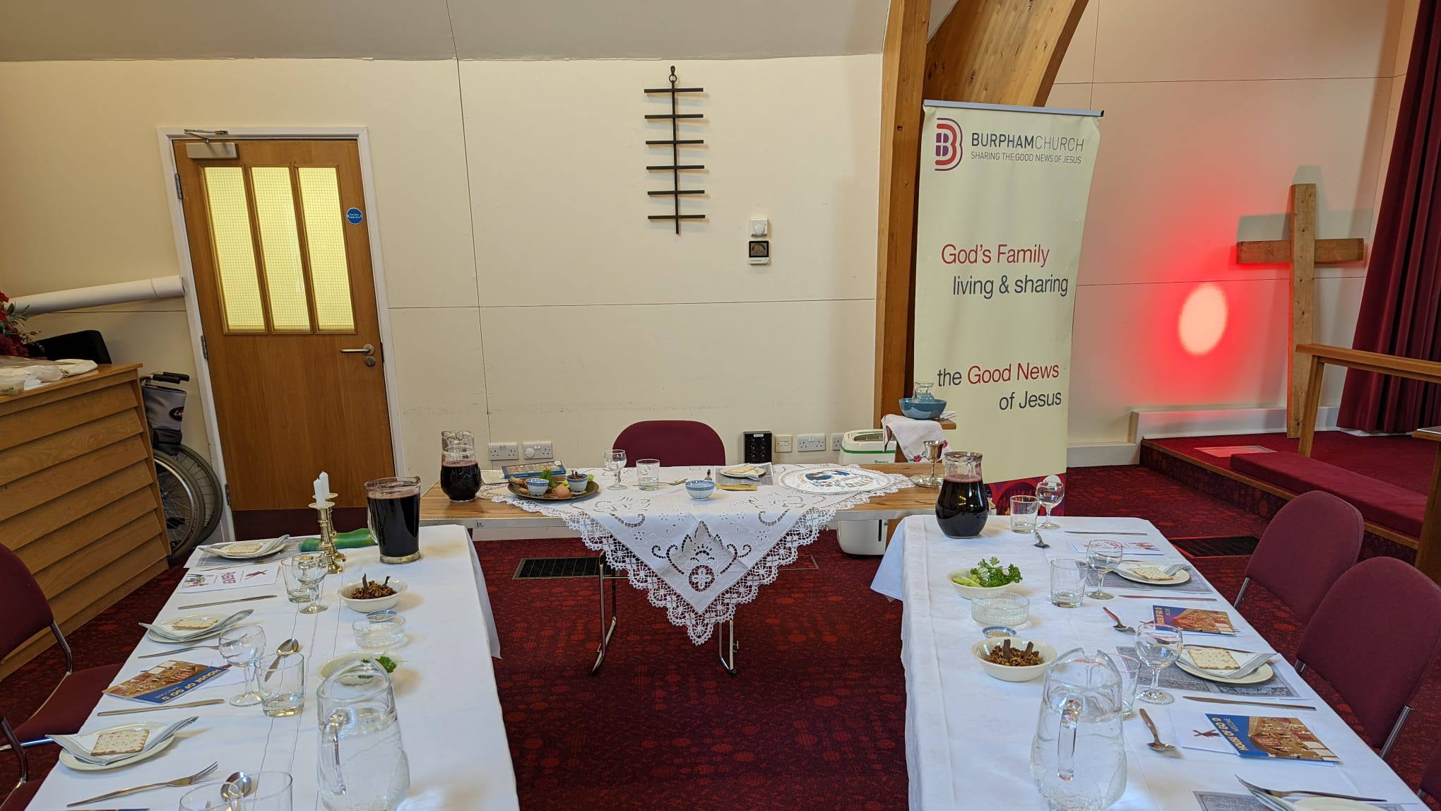
Youth Passover meal

Slide 8
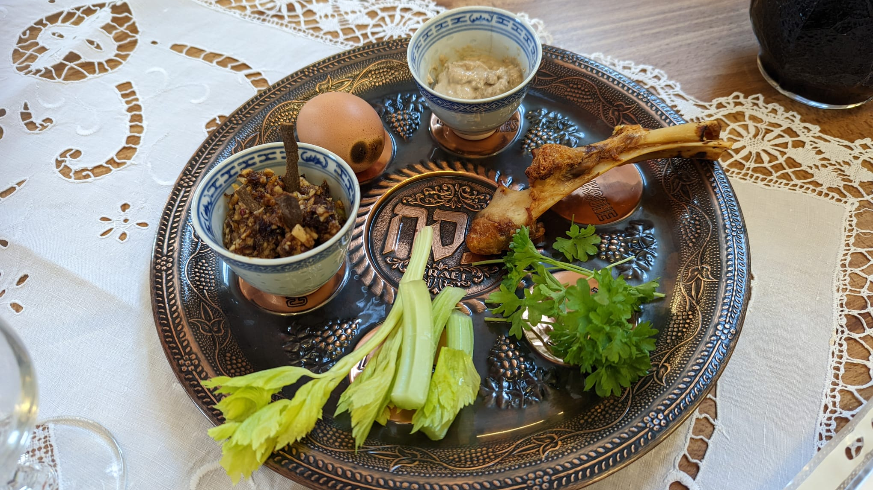
Youth Passover meal

Slide 9
Good Friday Walk at the Nature Reserve

Slide 10
Easter Eggstravaganza at St Luke’s

Slide 11
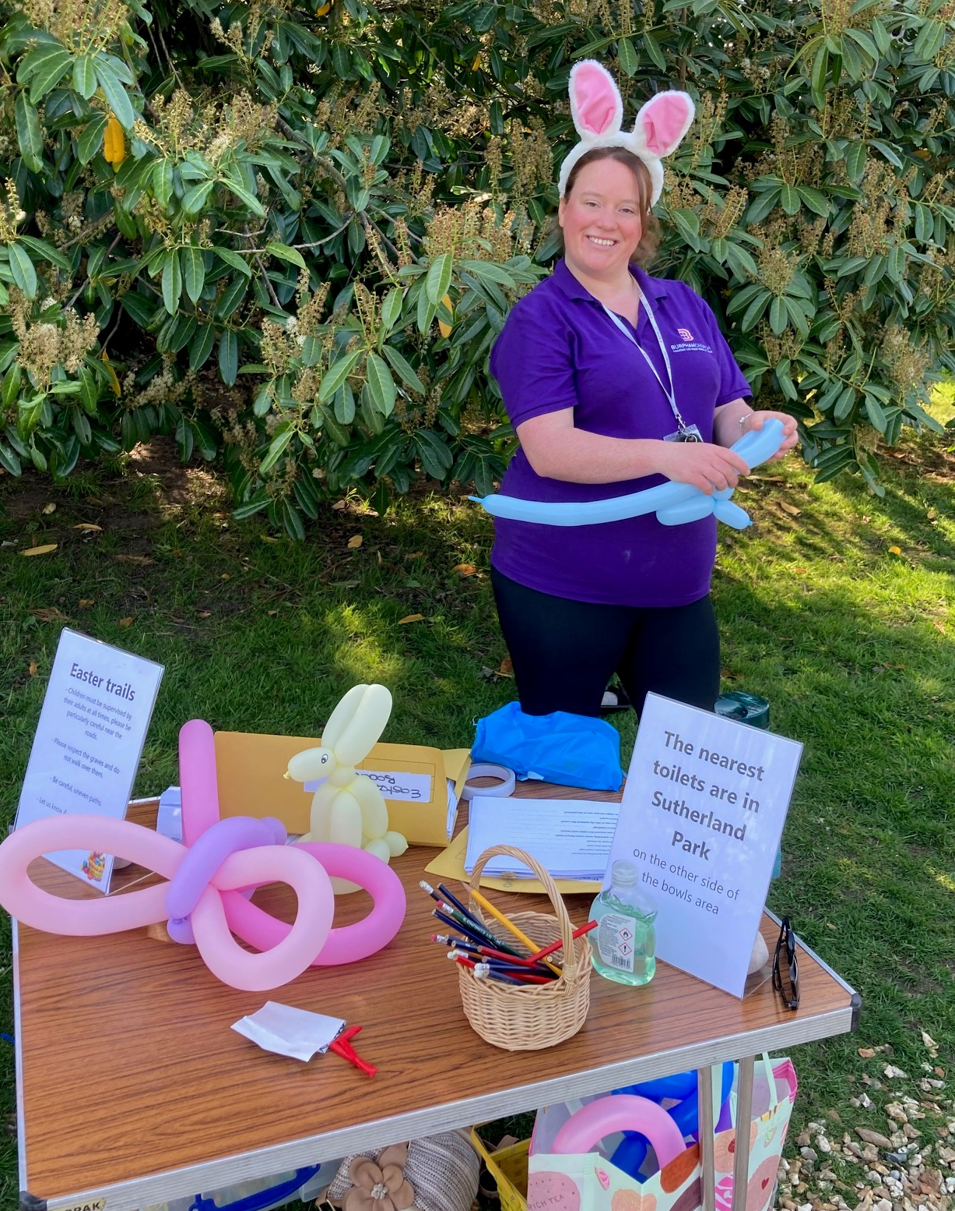
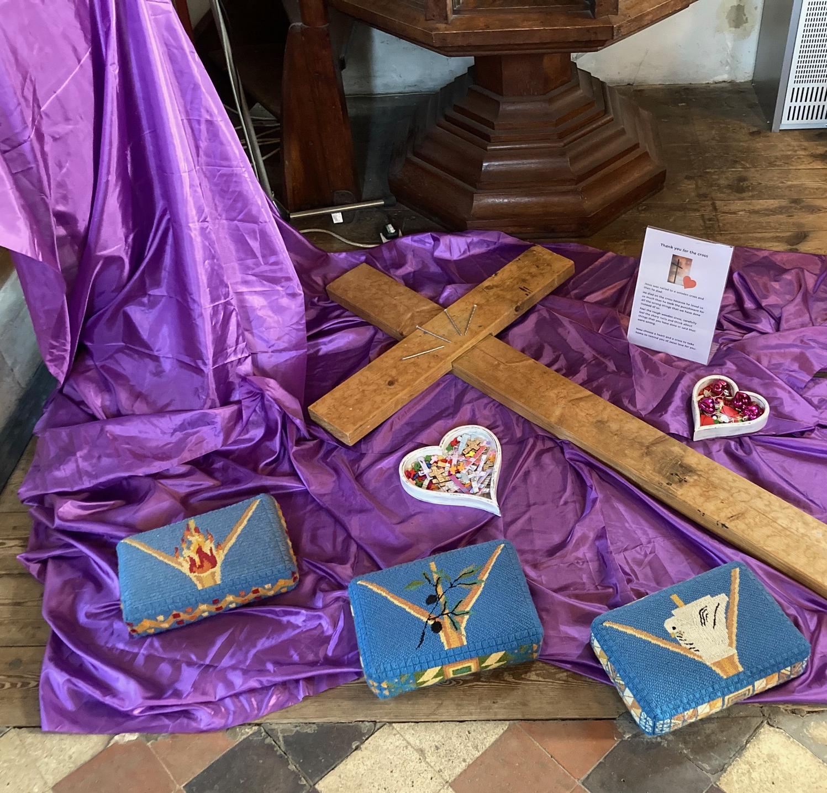
Easter Eggstravaganza at St Luke’s

Slide 12
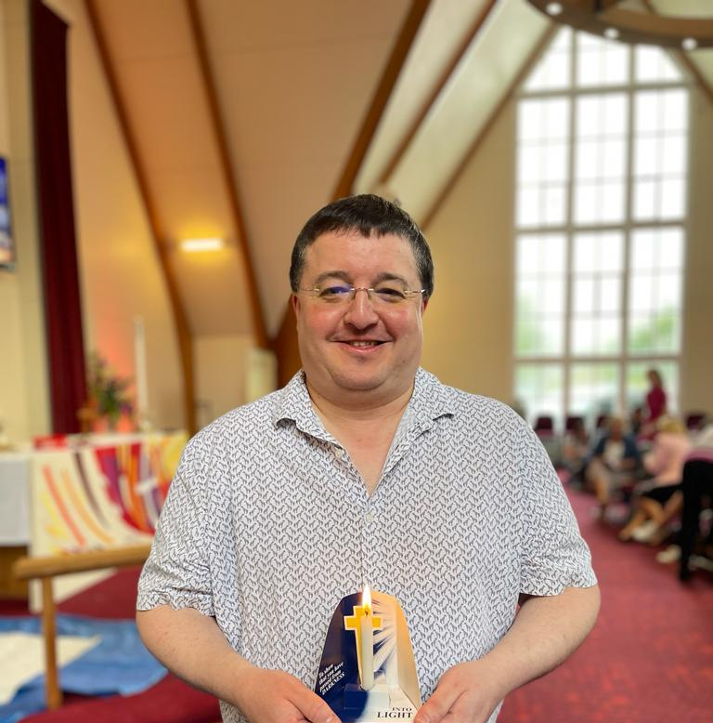
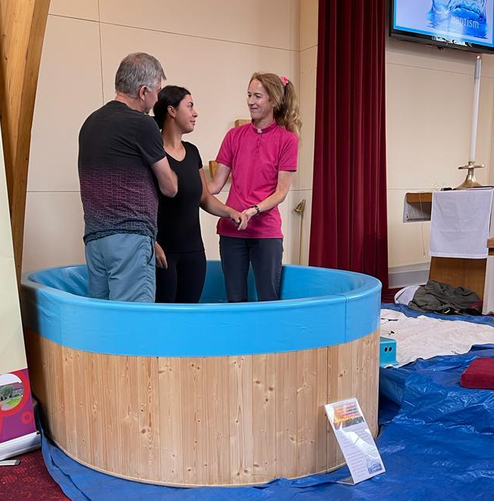
Baptisms of
Christian and Jade

Slide 14
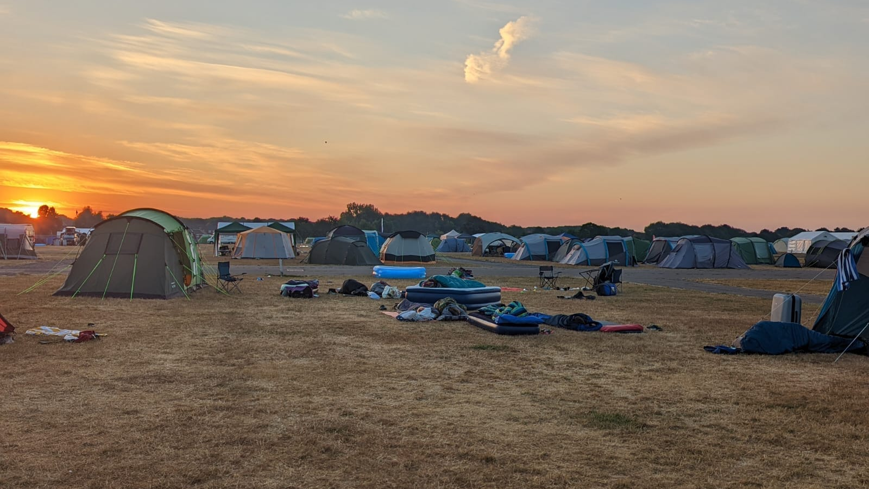
Satellites youth festival
Peterborough

Slide 15
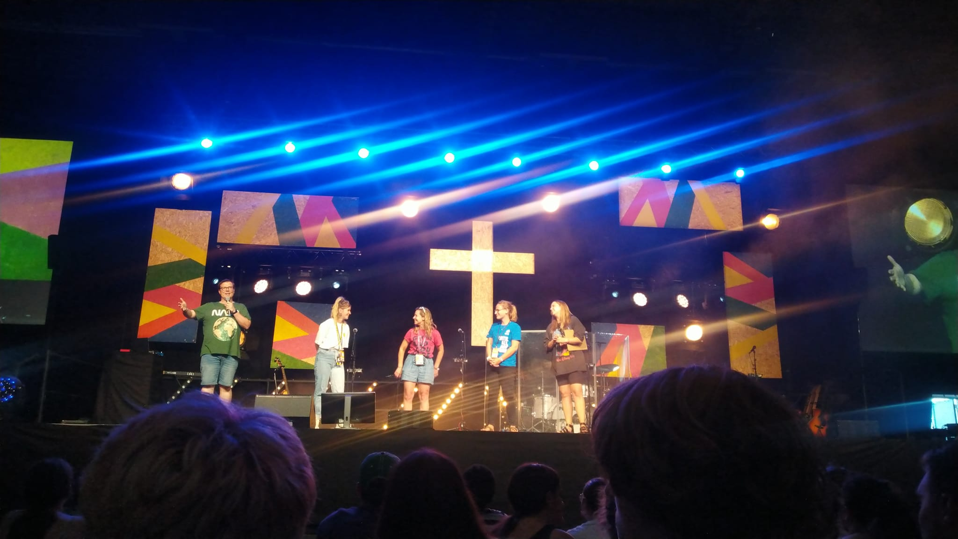
Satellites youth festival

Slide 16
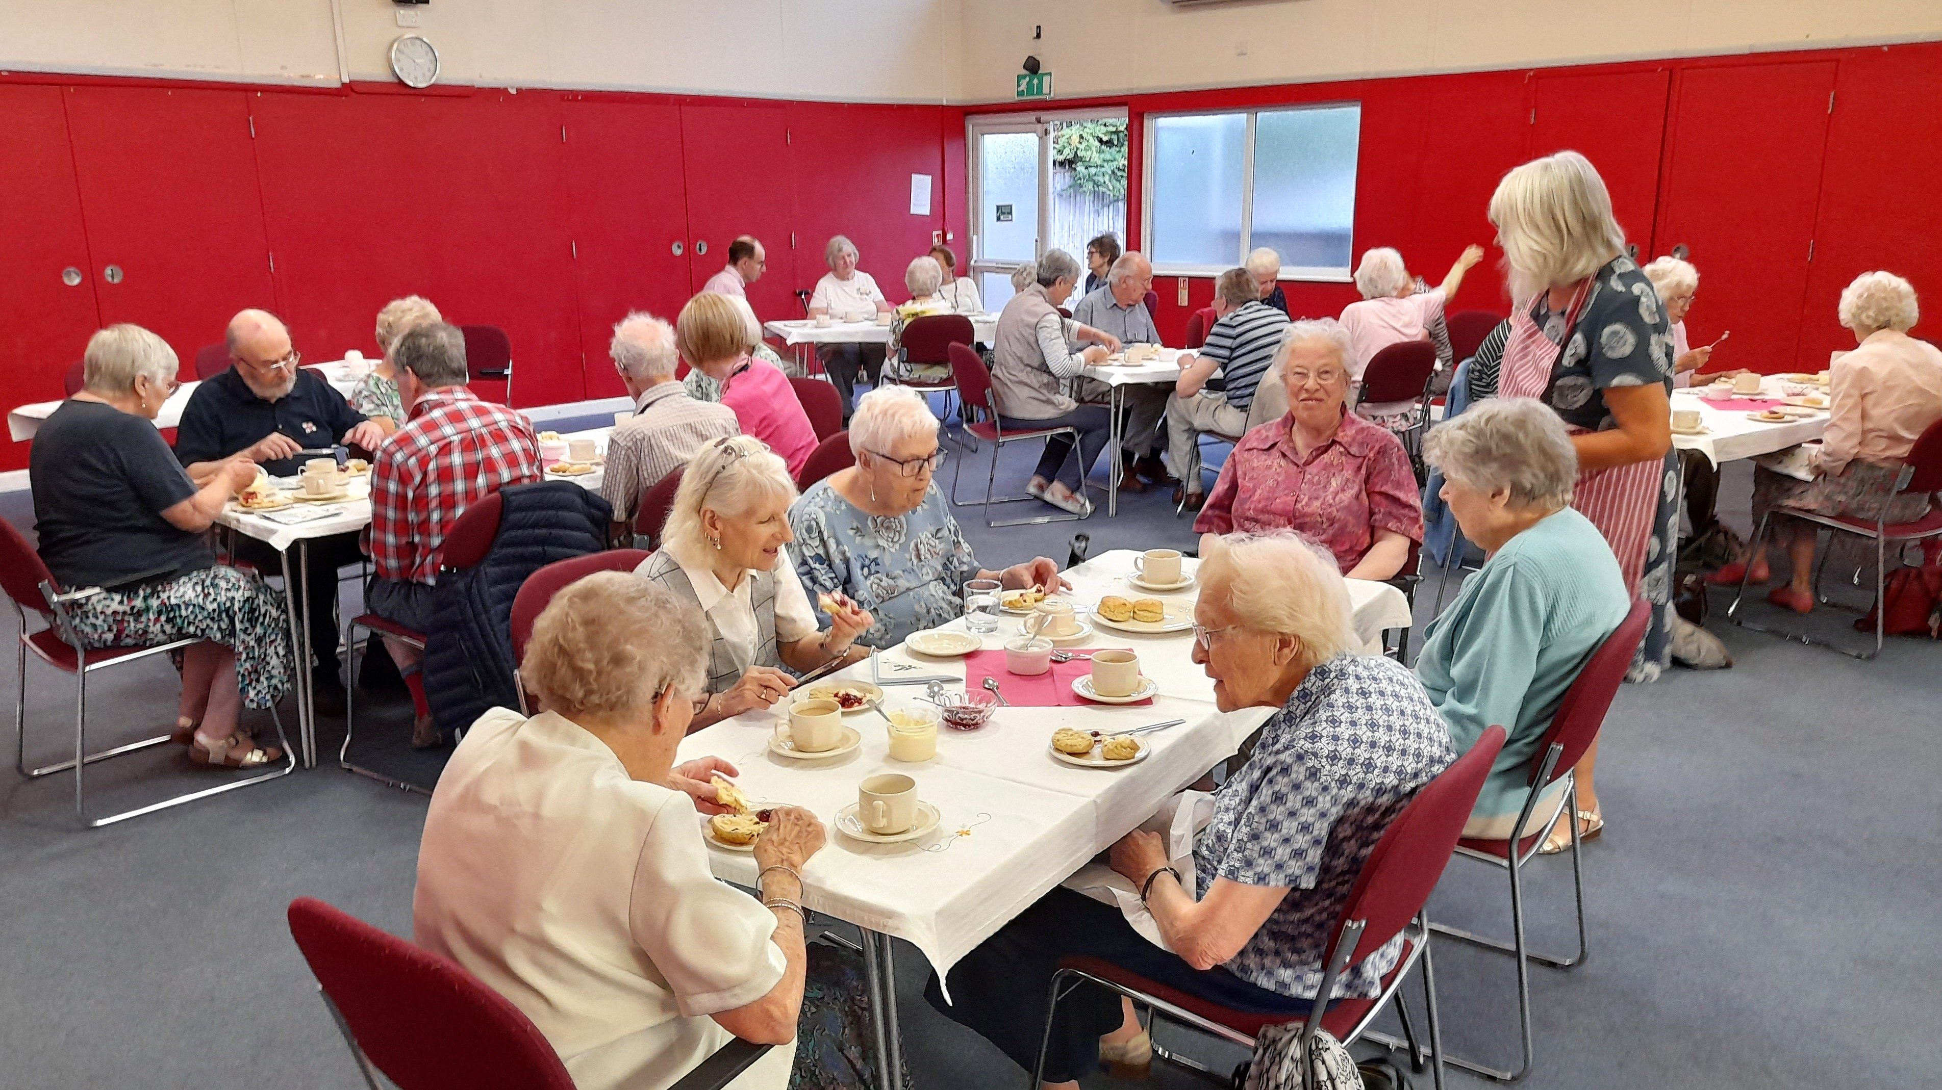
Drop In Summer Tea Party

Slide 17
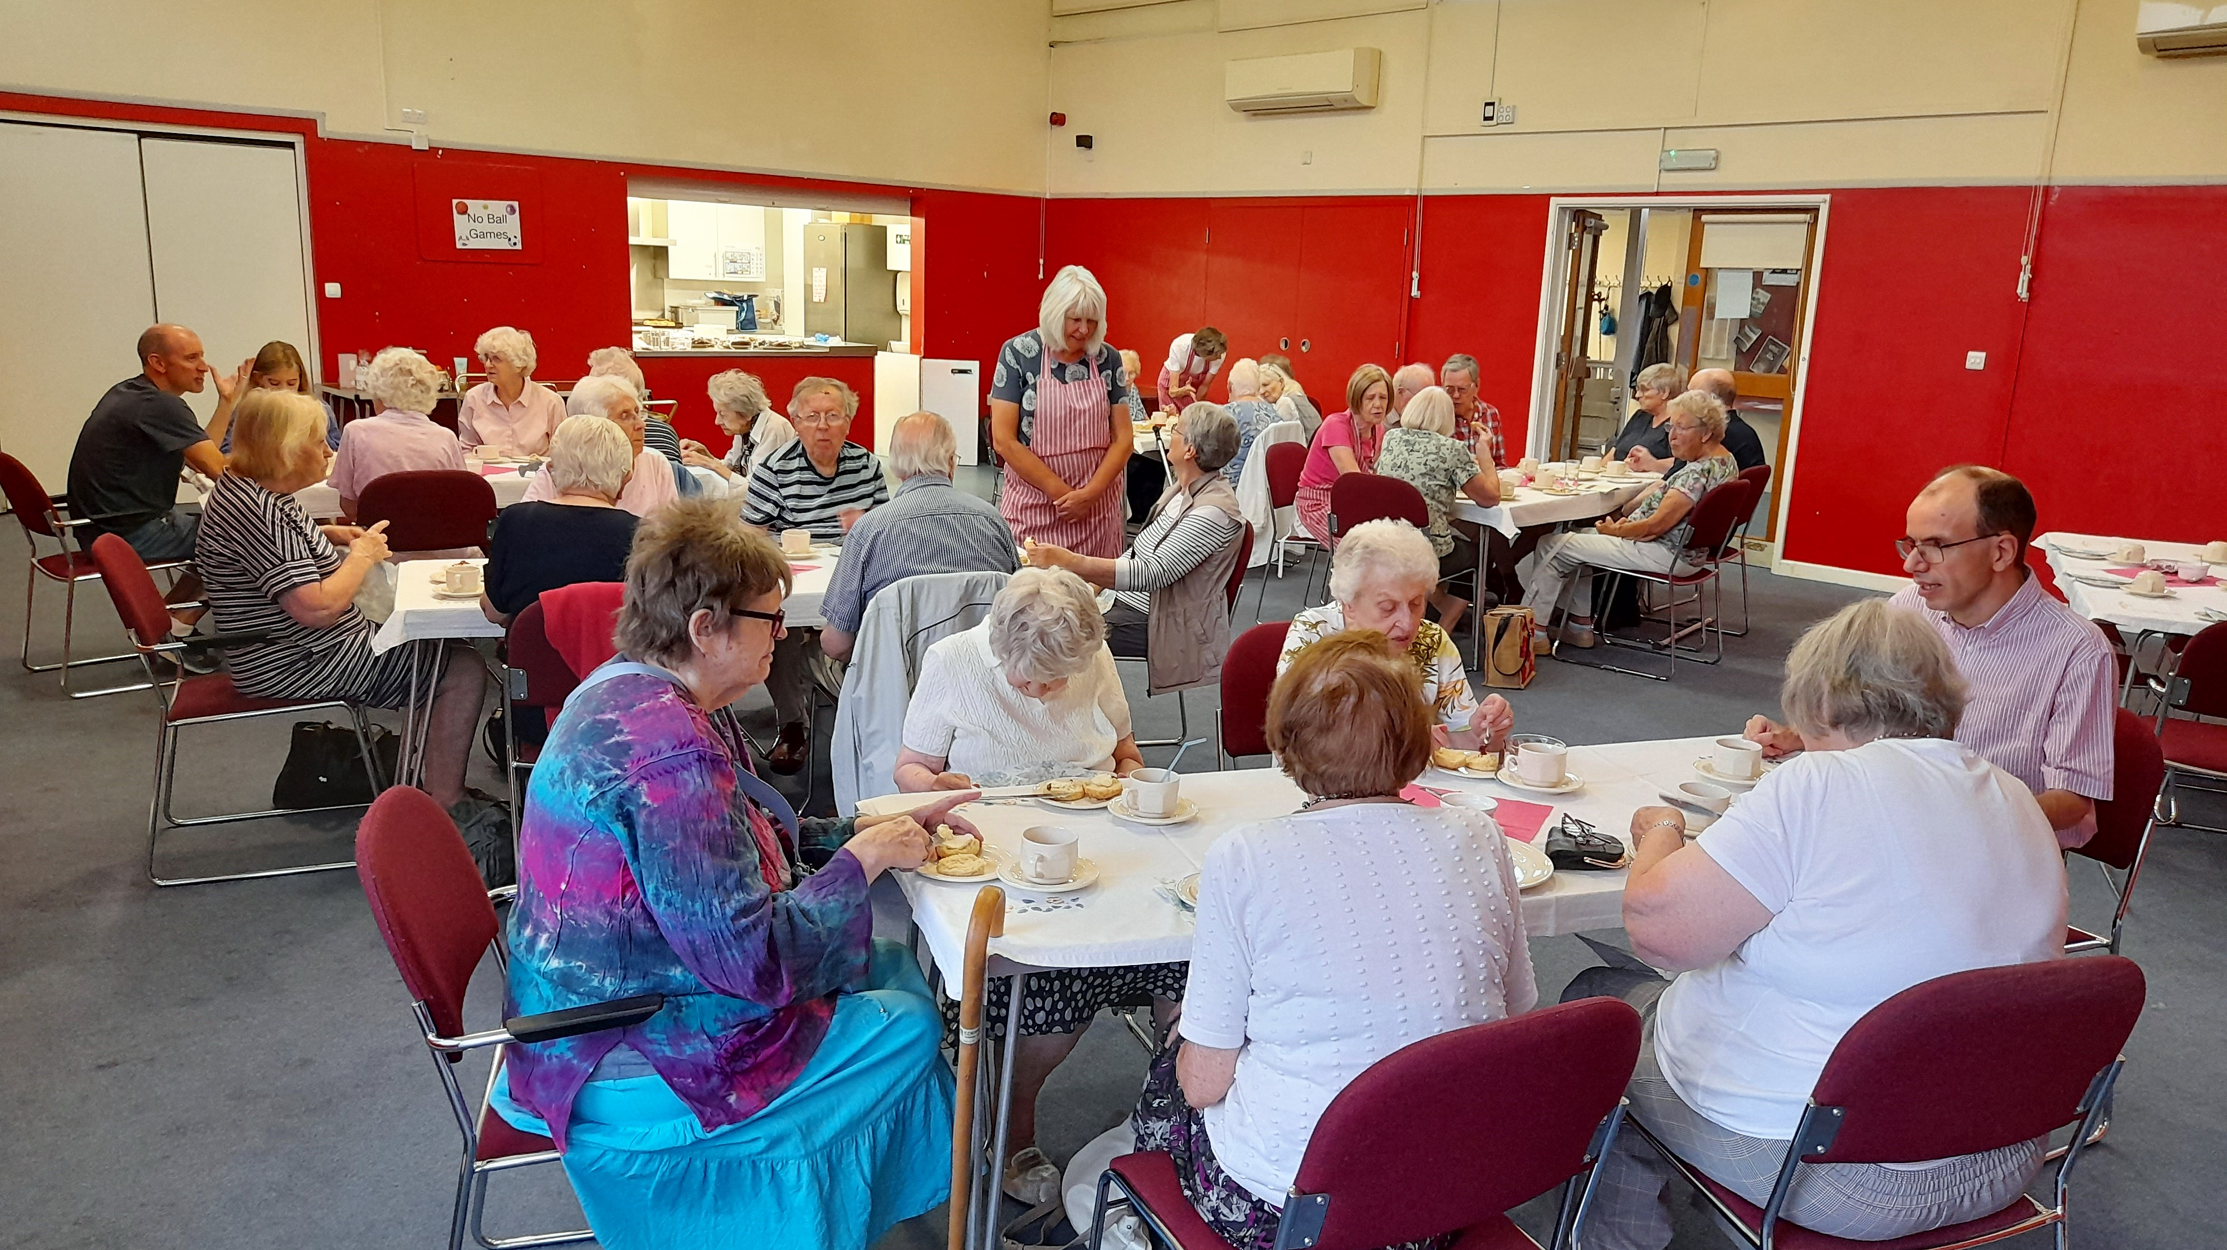
Drop In Summer Tea Party

Slide 18
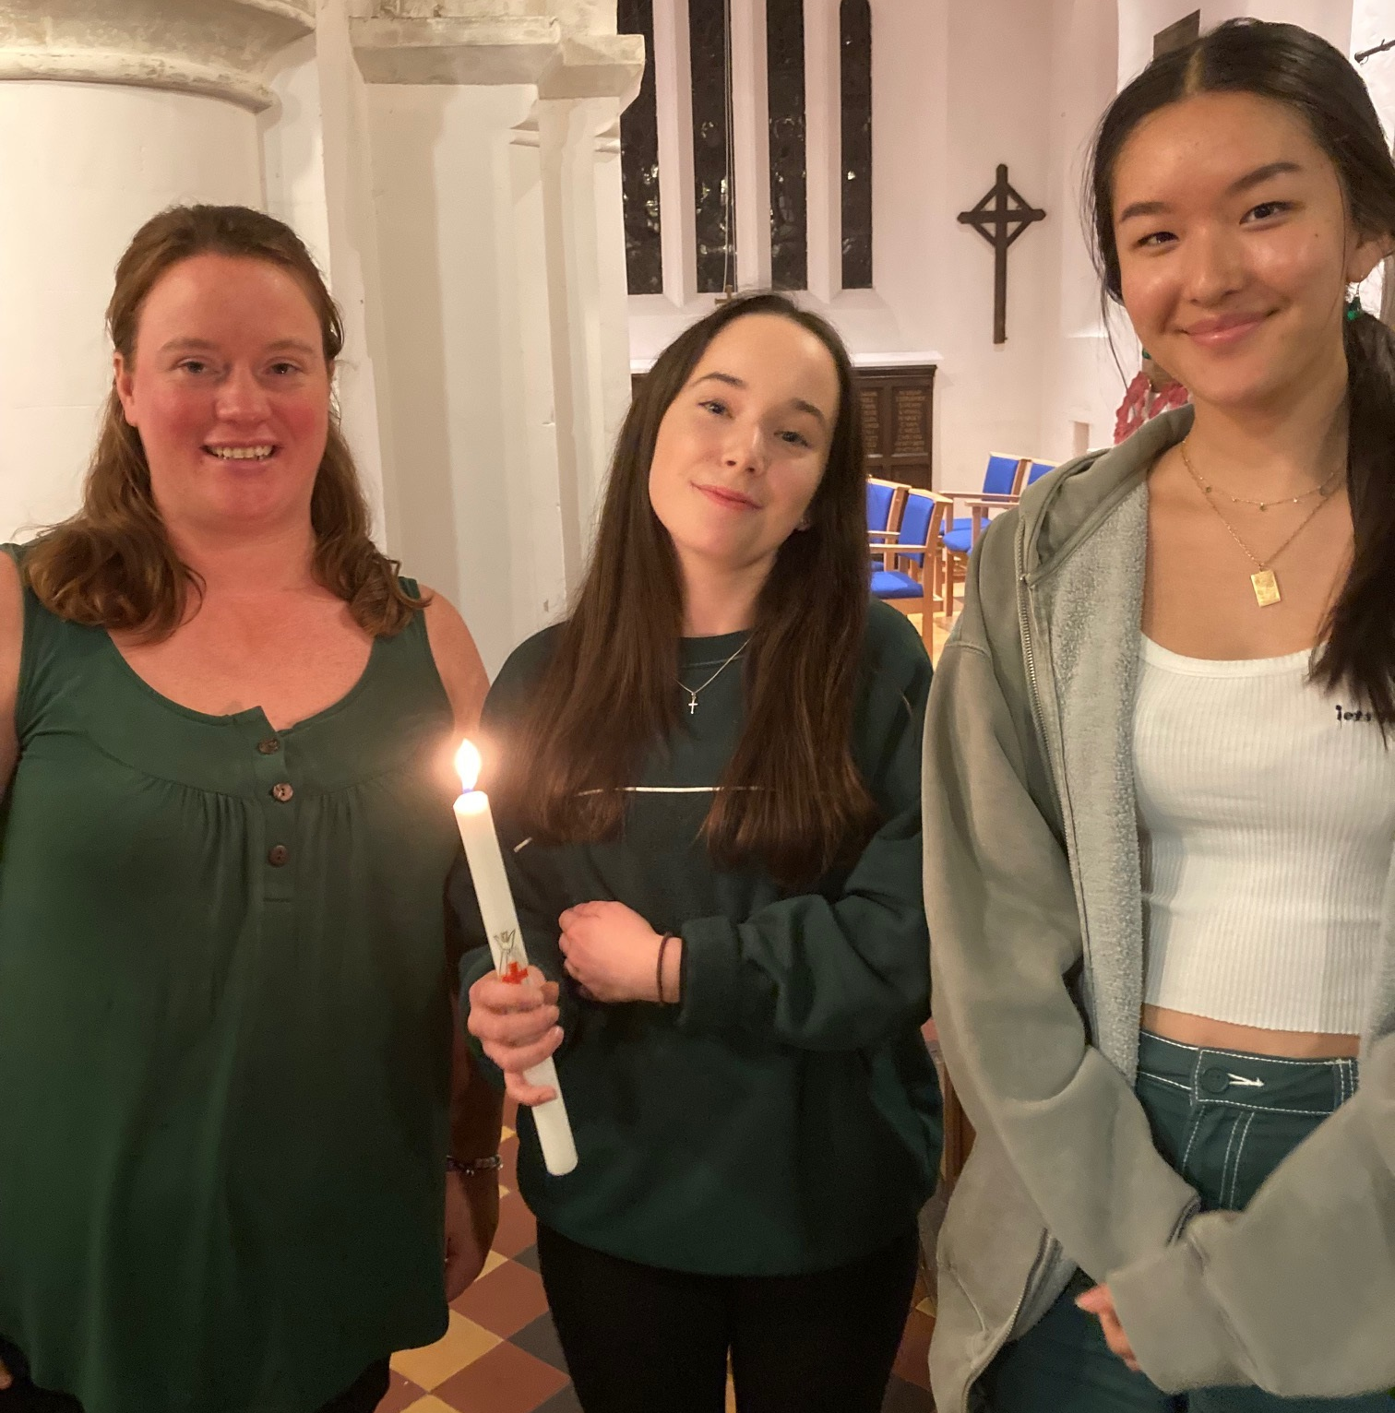
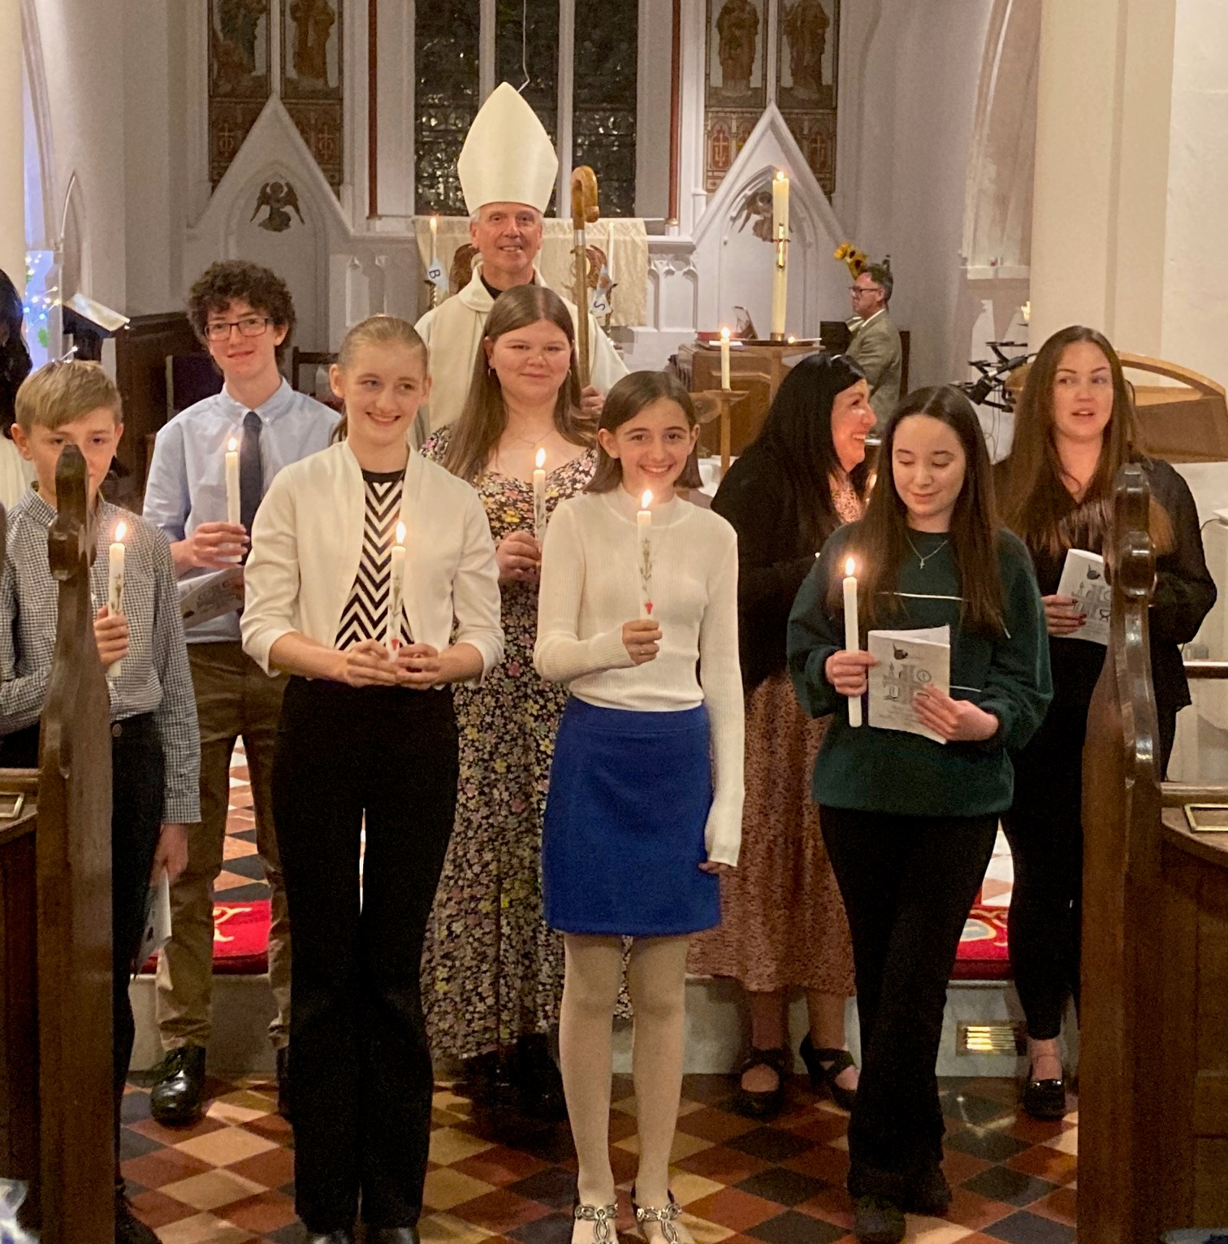
Annamieke’s Confirmation at St John’s Church Merrow

Slide 19
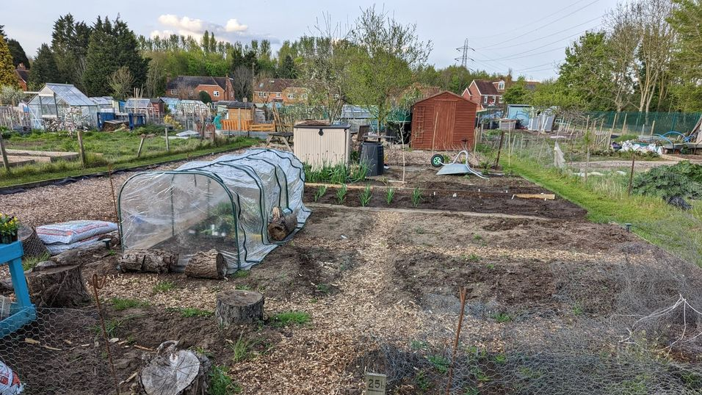
The Allotment
…at the start

Slide 20
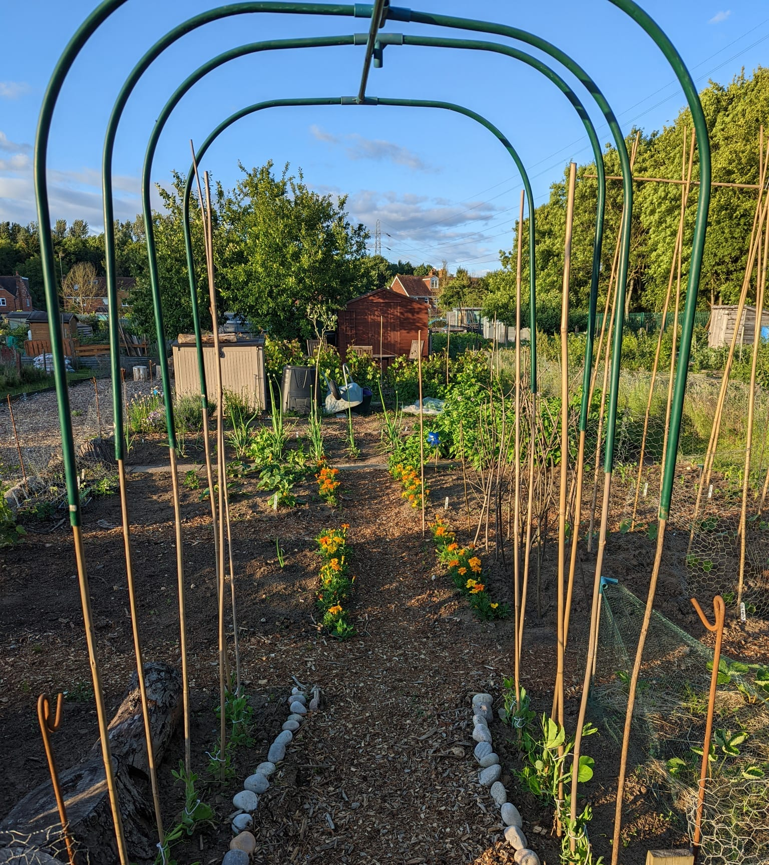
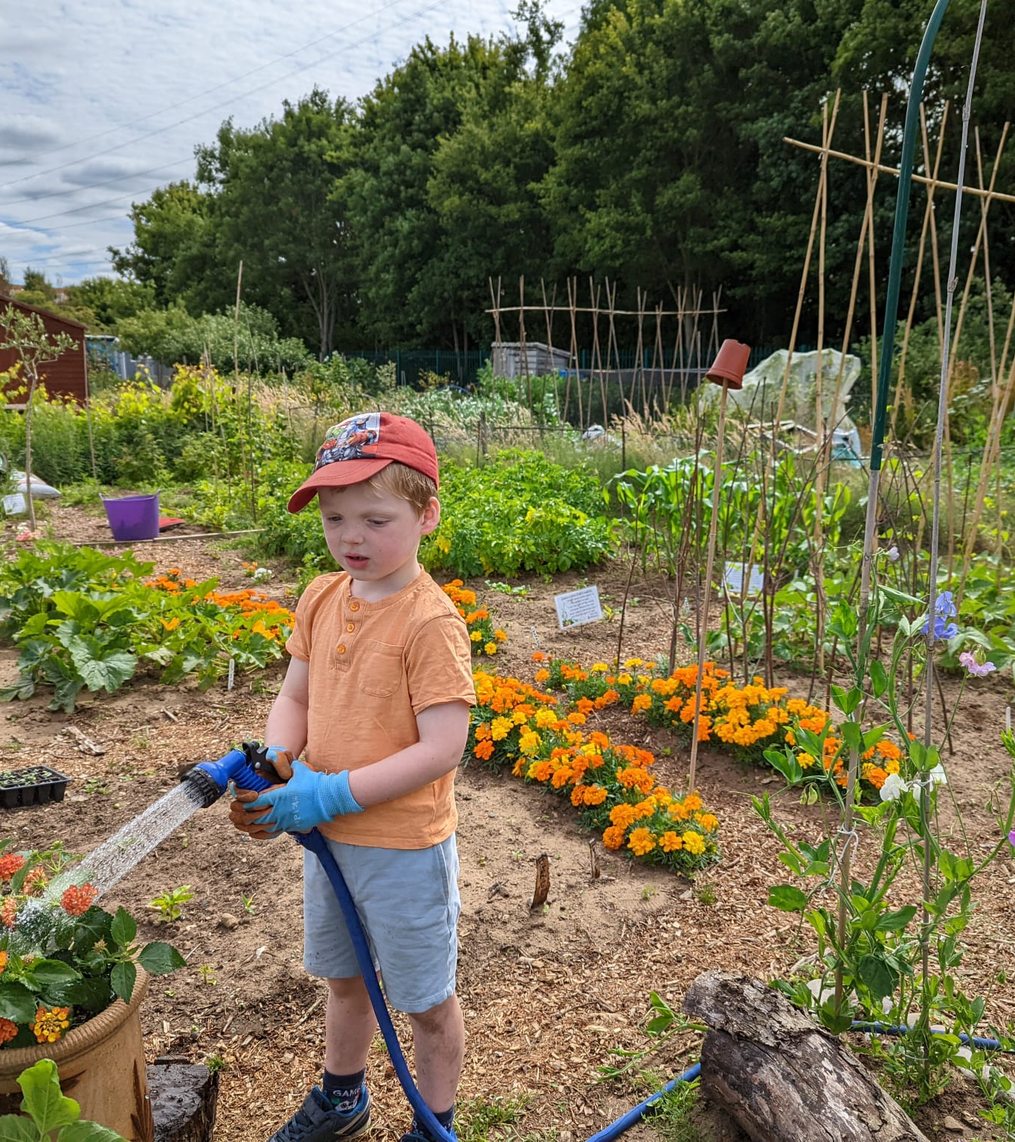
The Allotment
in progress

Slide 21
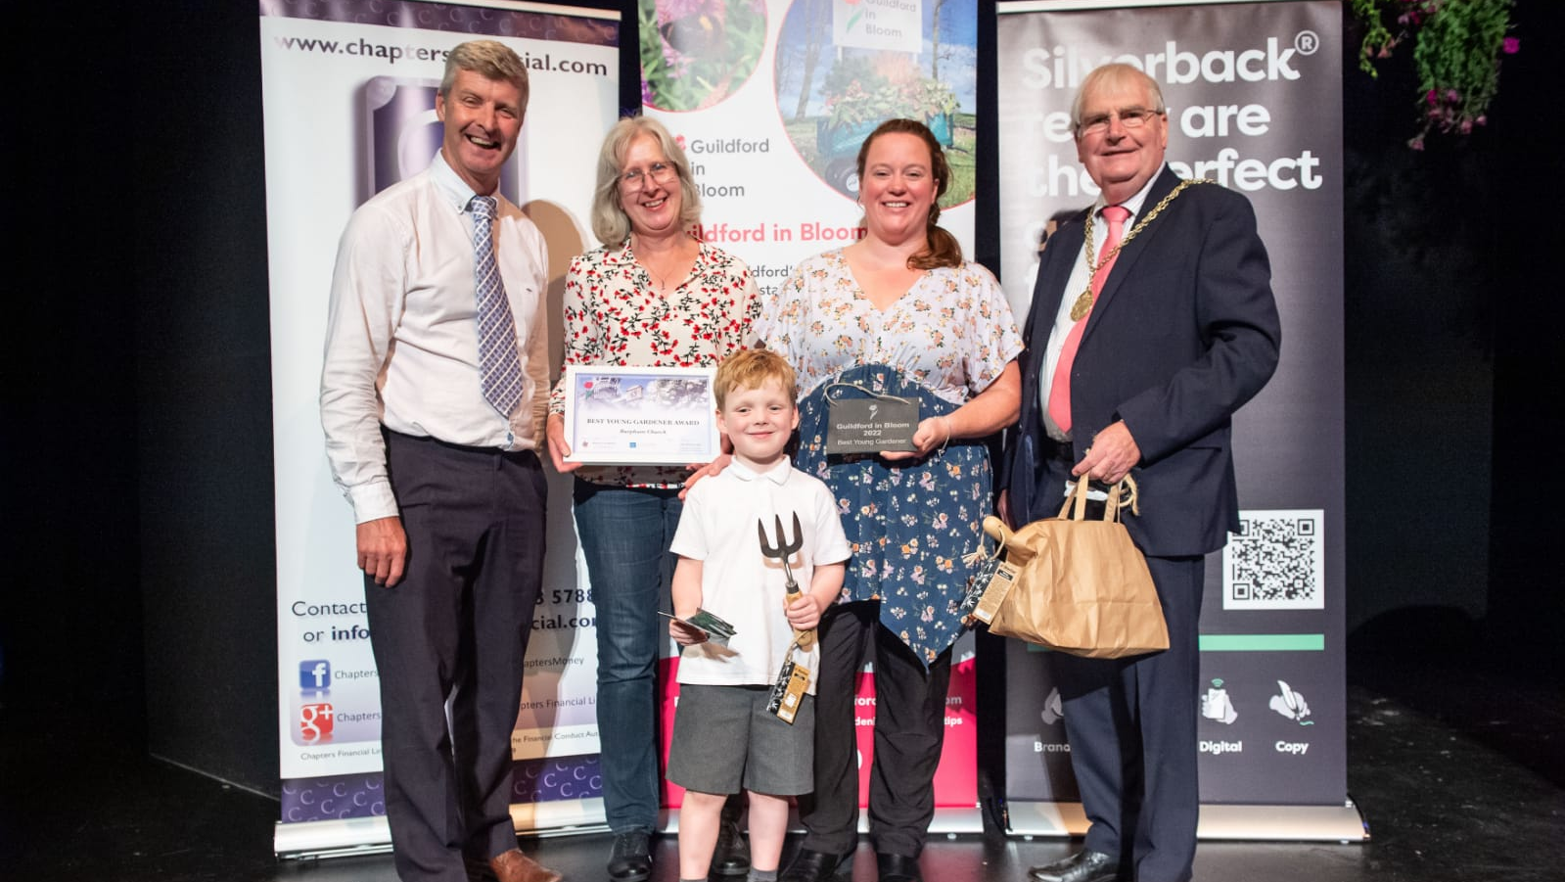
The Allotment
Prize winning!

Slide 22
The Allotment
Prize winning!

Slide 23
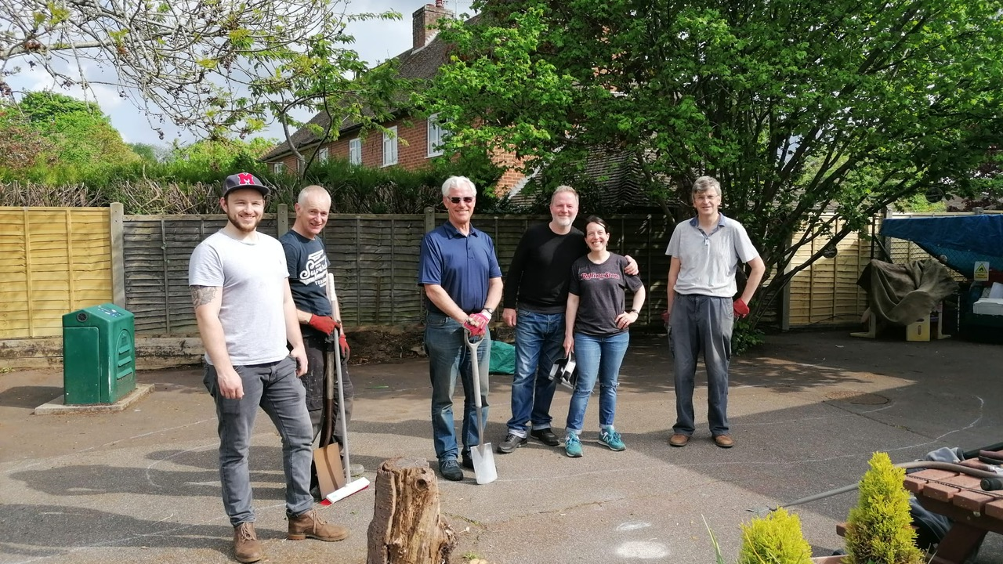
Working Party team

Slide 24
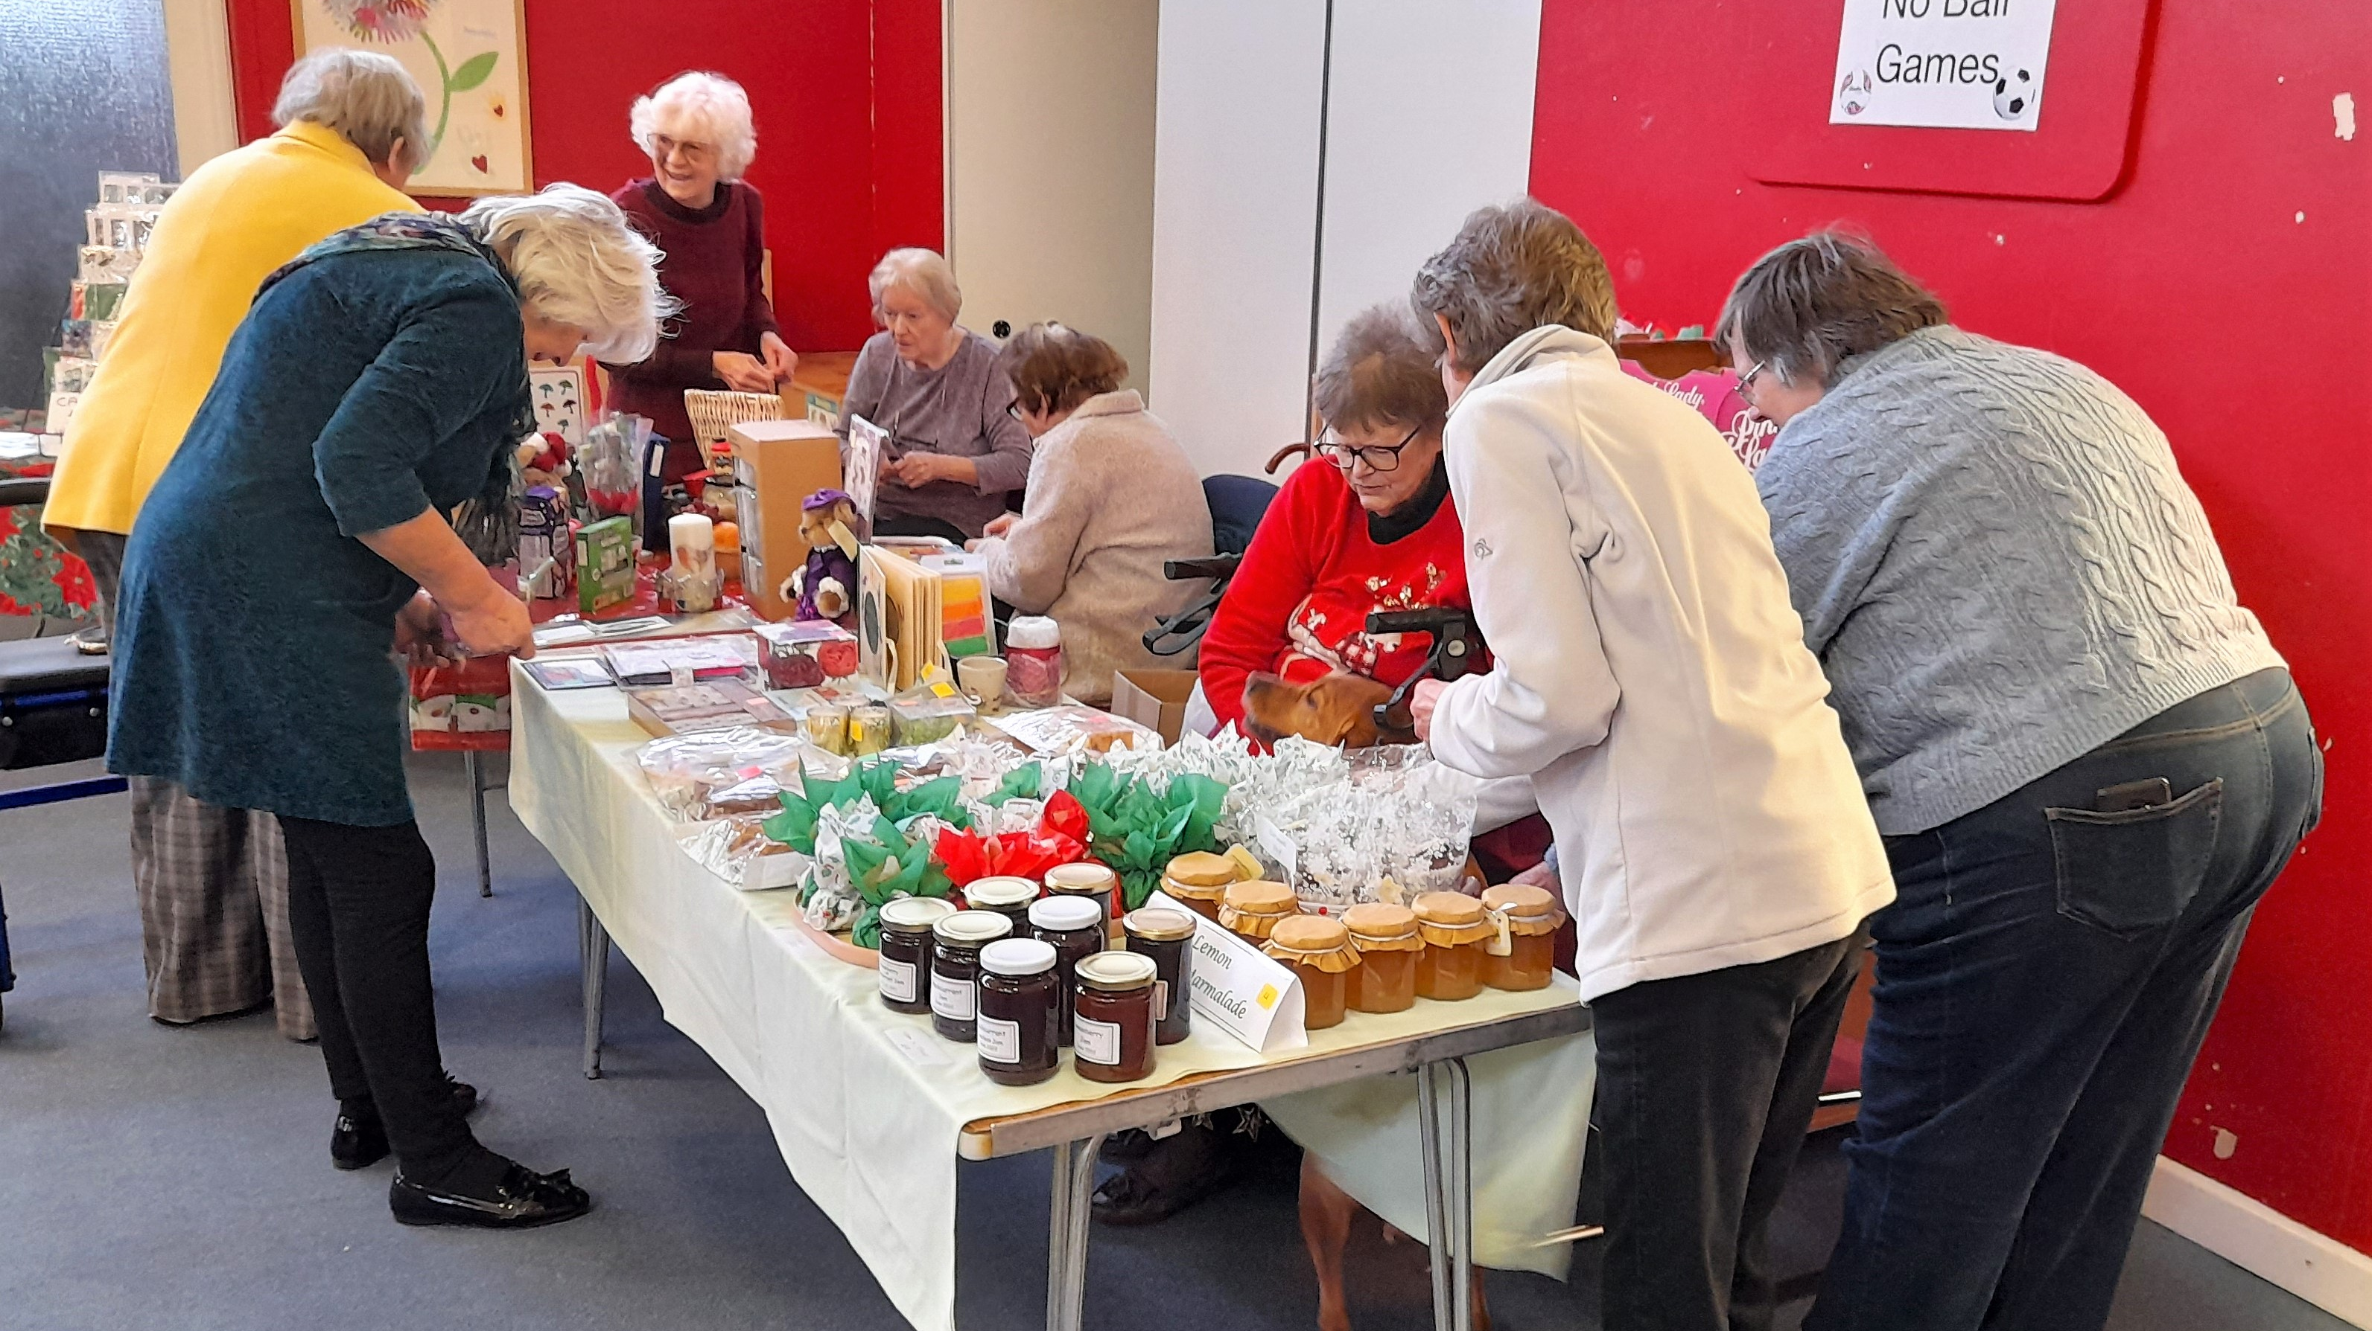
Drop In

Slide 25
Preschool Harvest Fair

Slide 27
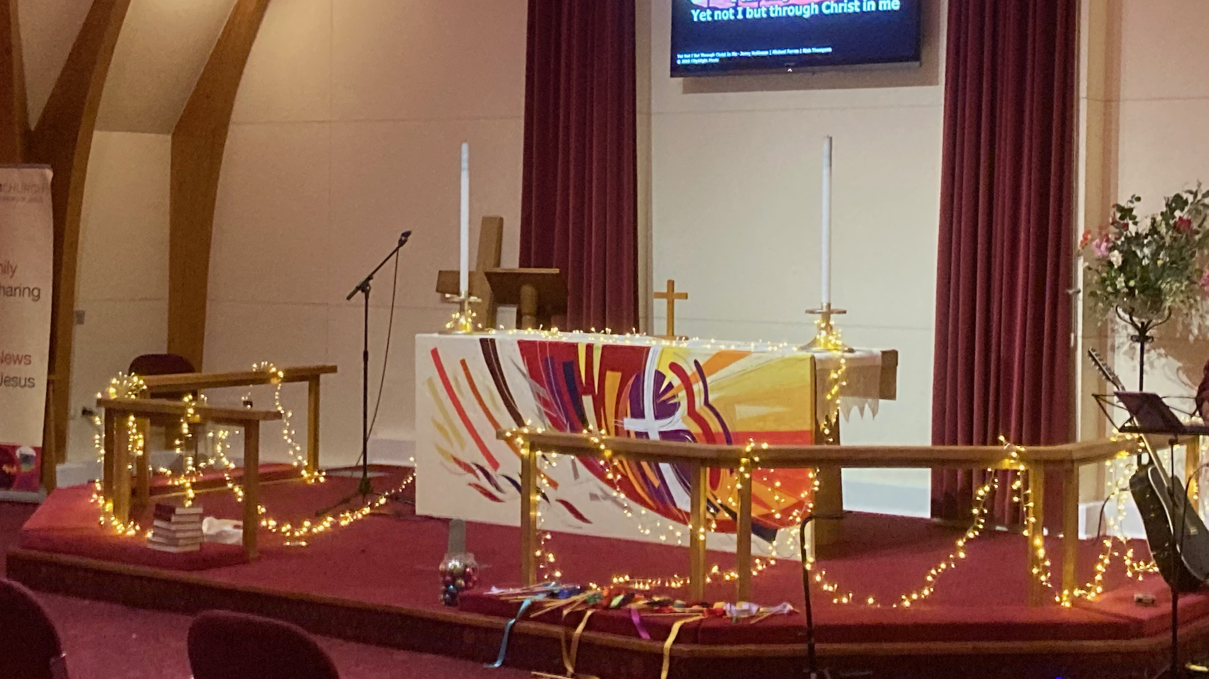
Light Party
31 October 22

Slide 28
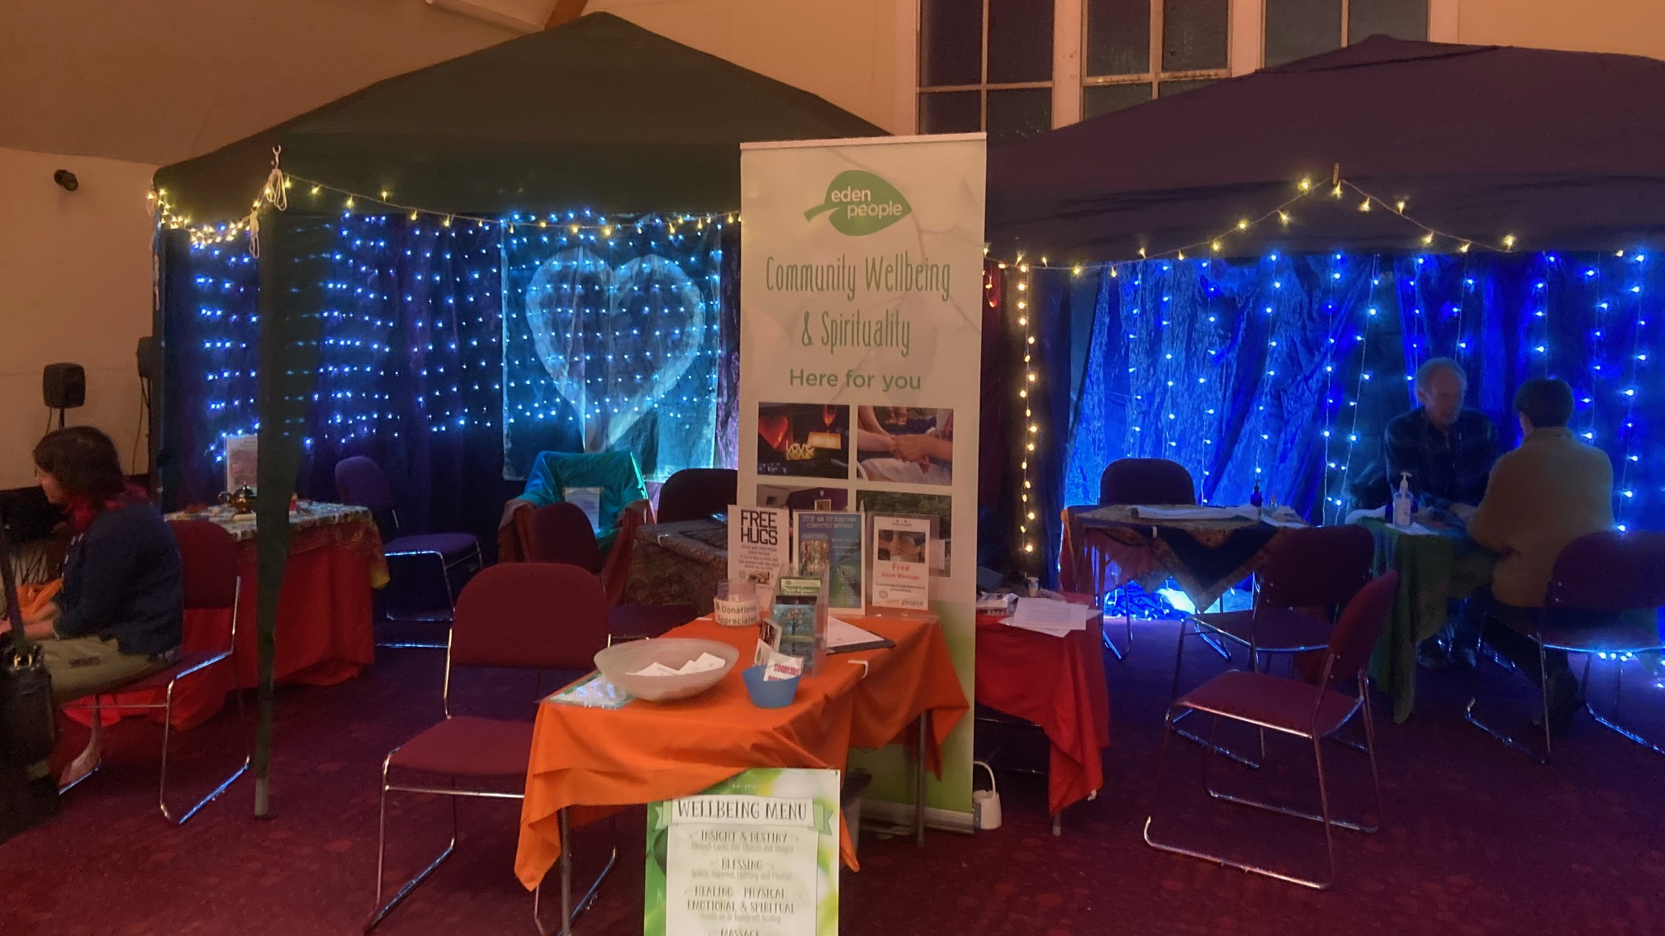
Church Fireworks Event

Slide 29
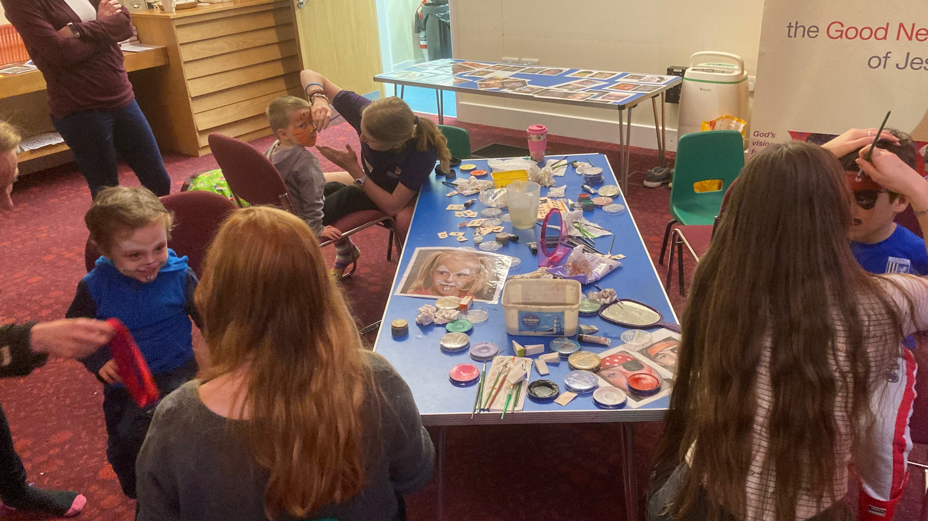
Church Fireworks Event

Slide 30
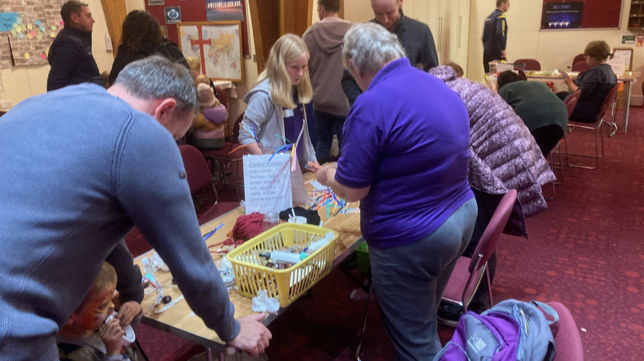
Church Fireworks Event

Slide 31
Church Fireworks Event

Slide 32
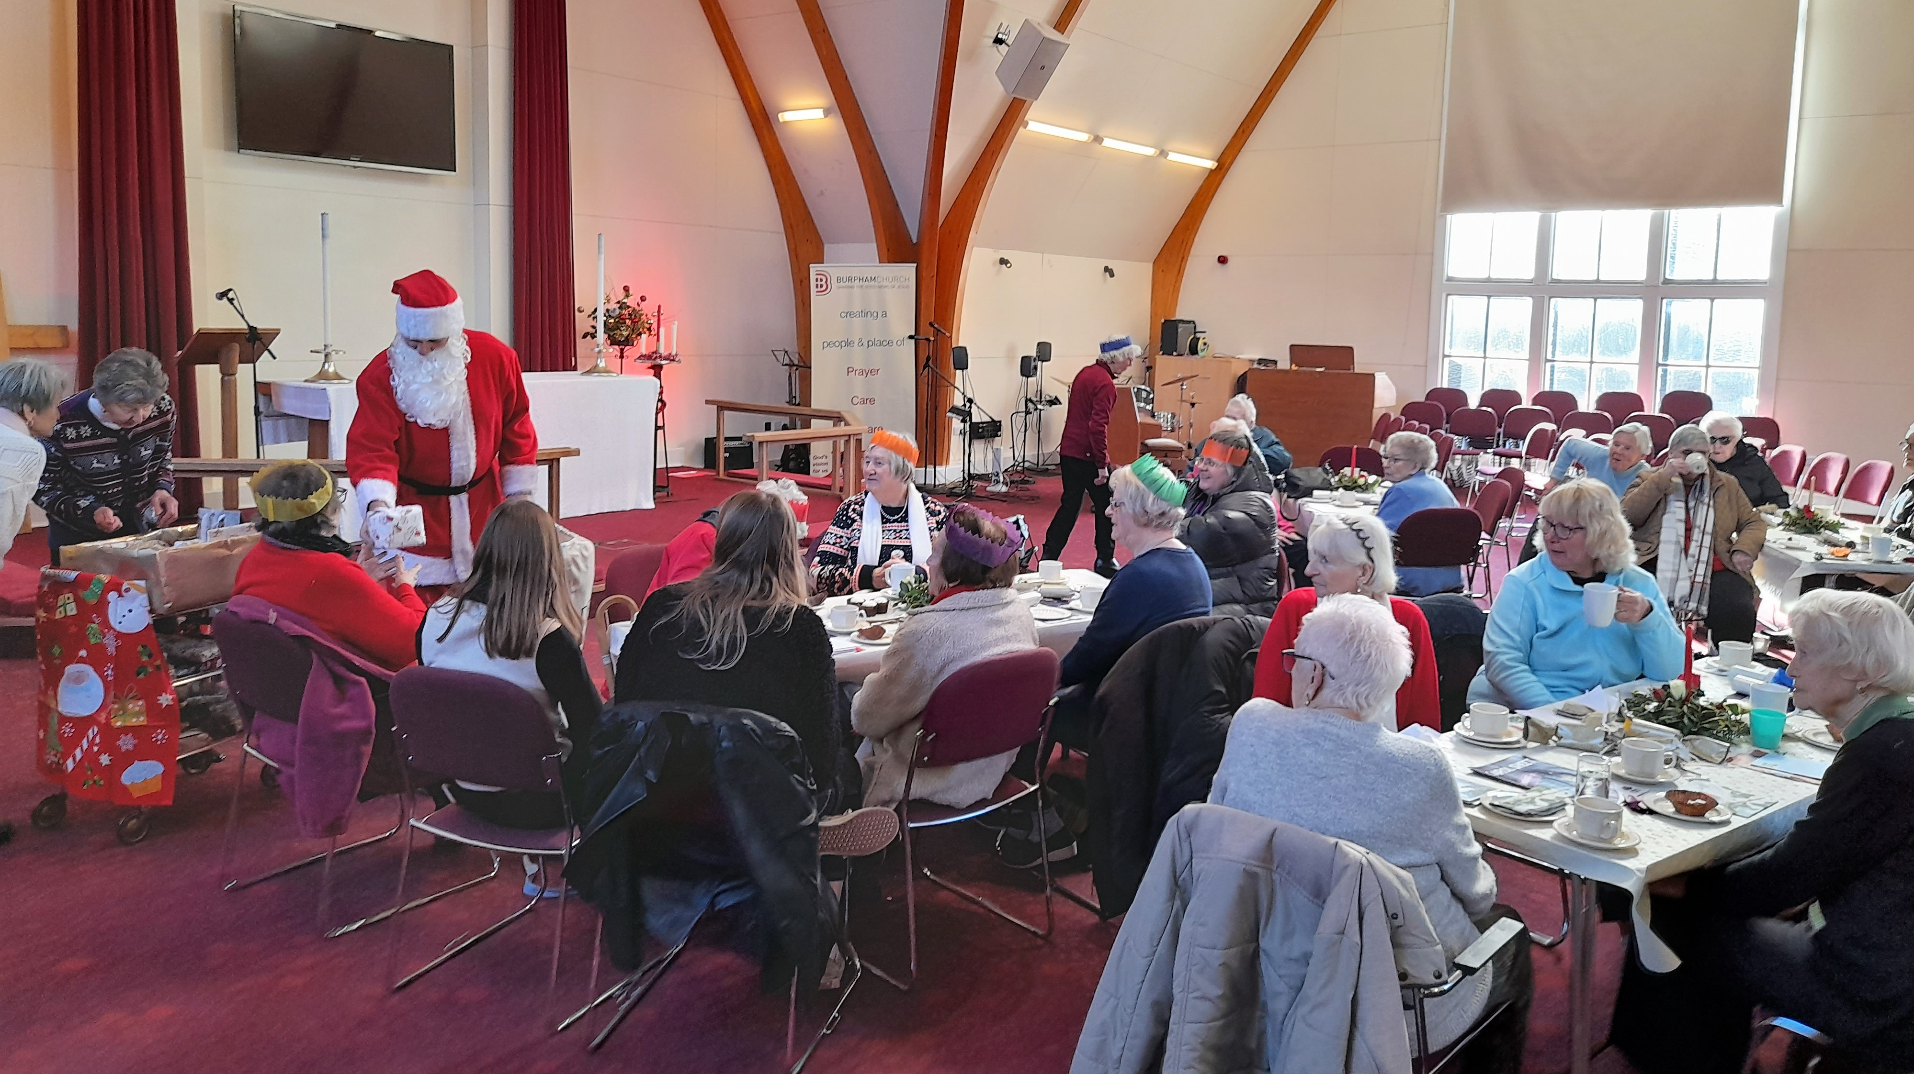
Drop In Christmas Celebration

Slide 33
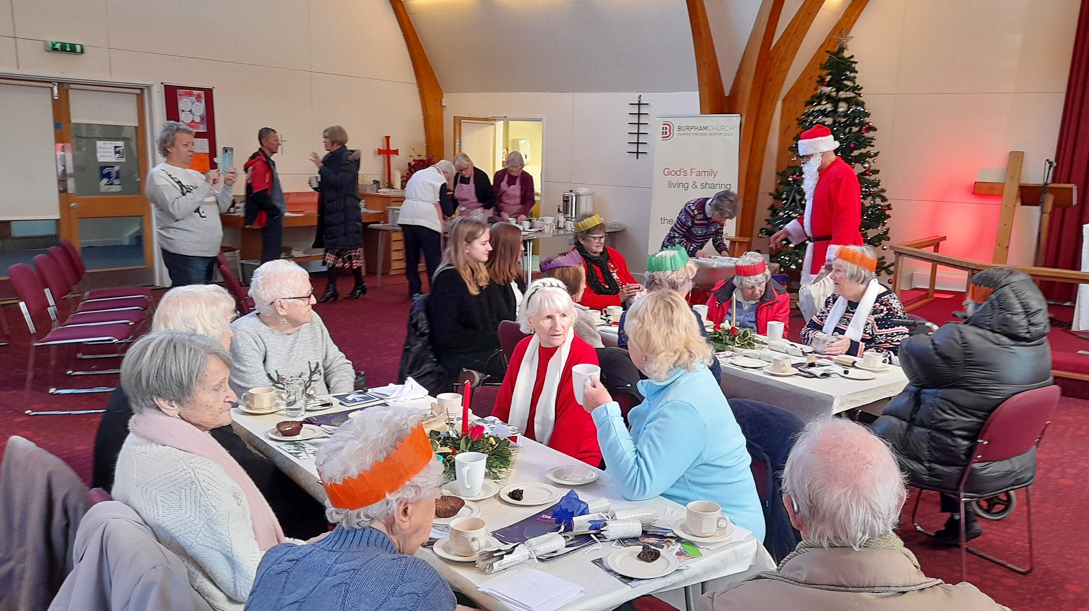
Drop In Christmas Celebration

Slide 34
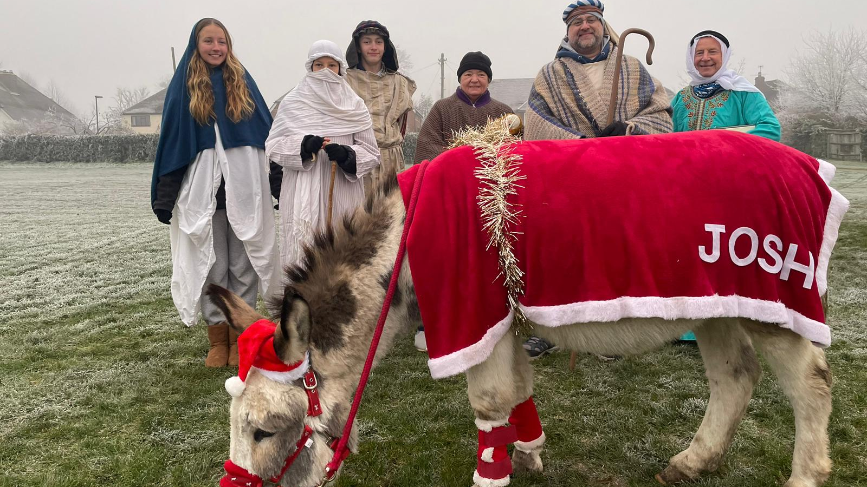
Carols in the Park

Slide 35
God’s family living and sharing the Good News of Jesus in Burpham

